Slide 1
Data Science Life-Cycle
Siddharth Agarwal

Slide 2
Working with FOREX data
Using USD-EURO data

Slide 3
Agenda
We will knowing about how to take on a simple forecasting/prediction problem
Solve it using python on a Jupyter Notebook
Gentle Introduction to various statistical terms.
Know how to get better results using Deep Learning.

Slide 4
Problem
We will be using the USD-EURO exchange rate to predict future exchange rates.
We would be using exchange date from 1974 to 2019.
Since this is a general introduction I won’t be using any deep learning techniques like RNN or LSTM.

Slide 5
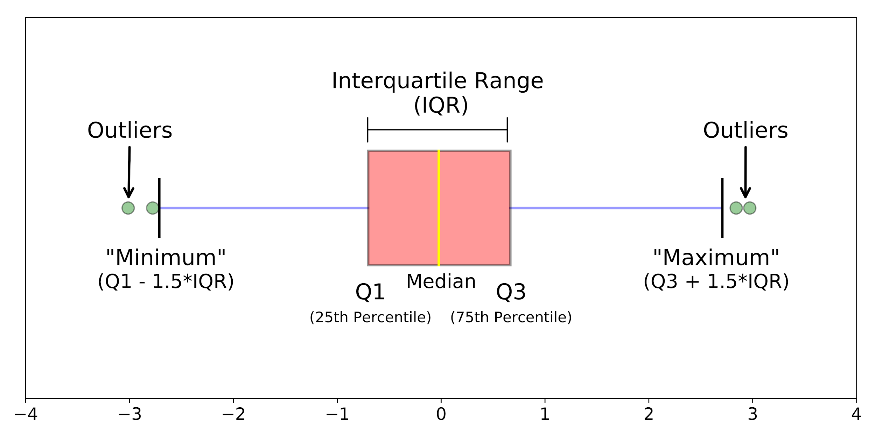
Box-plots, Outliers, Scaling
nnn
Normalization : Helps in scaling down your features between 0-1. Eg- Minmax Scaler
Standardization: Scales down features based on SND, mean=0, SD=1 . Eg- Standard Scaler

Slide 6
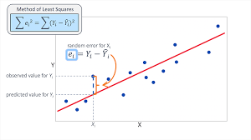
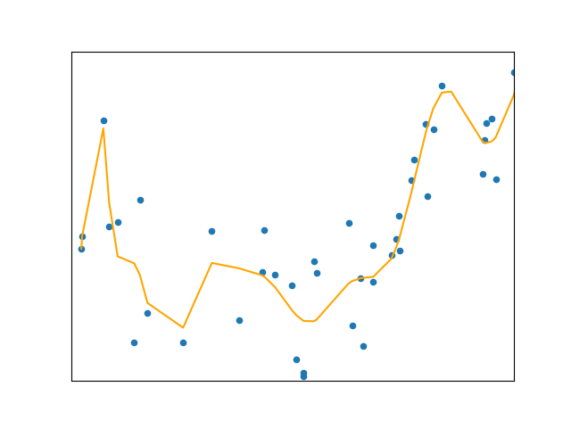
Linear Regression
Linear regression is used for finding linear relationship between target and one or more predictors.
Metrics:
Bias
Variance
Error Rates

Slide 7
Resources
StatQuest (YT)
3 Blue 1 Brown
Krish Naik
Sentdex
Brandon Rohrer
Blogs
KDNuggets
Towards Data Science
Analytics Vidhya
My name is Siddharth Agarwal, I am a 3rd Year Undergrad at HIT-K.
I Have a Startup Named J4Jugaad.
My areas of interest are Data Science, Business Development, ML and I am also a noob marketeer.
Do send a connection request at
https://www.linkedin.com/in/siddharth-agarwal-382590162/
https://github.com/2000siddharth

Slide 8

Thanks!
Contact me:
sidagarwal43@gmail.com

